Slide 1
Agile Development
Topic 2:
Approach and Principles
Notes:
NCC Education - Title Master

Slide 2
Topic 2 Coverage
This topic will cover:
    The Agile Manifesto;
    What is meant by DSDM Atern;
    The structure of DSDM Atern;
    The philosophy and principles of DSDM Atern;
    When to use DSDM Atern.
Notes:
NCC Education - Slide Master

Slide 3
The Agile Manifesto
We are uncovering better ways of developing software by doing it and helping others do it.
Through this work we have come to value:
  Individuals and interactions over processes and tools
  Working software over comprehensive documentation
  Customer collaboration over contract negotiation
  Responding to change over following a plan
That is, while there is value in the items on the right, we value the items on the left more
www.agilemanifesto.org (2001)
Notes:
The Agile Manifesto was created in 2001 by a group of programming professionals who named themselves ‘The Agile Alliance’.
They had experienced first hand the issues relating to projects that were considered to have failed as they had not meant either the budget or the time scales required. They understood that the failings were not theirs, but that of the system and project planning structure. Their efforts have helped to shape software project management, and now project management outside of the software industry.
There are 12 principles that the manifesto work to:
Our highest priority is to satisfy the customer
through early and continuous delivery
of valuable software.
Welcome changing requirements, even late in
development. Agile processes harness change for
the customer's competitive advantage.
Deliver working software frequently, from a
couple of weeks to a couple of months, with a
preference to the shorter timescale.
Business people and developers must work
together daily throughout the project.
Build projects around motivated individuals.
Give them the environment and support they need,
and trust them to get the job done.
The most efficient and effective method of
conveying information to and within a development
team is face-to-face conversation.
Working software is the primary measure of progress.
Agile processes promote sustainable development.
The sponsors, developers, and users should be able
to maintain a constant pace indefinitely.
Continuous attention to technical excellence
and good design enhances agility.
Simplicity--the art of maximizing the amount
of work not done--is essential.
The best architectures, requirements, and designs
emerge from self-organizing teams.
At regular intervals, the team reflects on how
to become more effective, then tunes and adjusts
its behaviour accordingly.
A detailed history can be found at http://agilemanifesto.org/history.html

Slide 4
What is DSDM?
  It is an Agile Project Delivery Framework that delivers the right solution at the right time. Features include:
    Any kind of project
    Focused on business benefit
    On-time and in budget
    Quality and rigour
    Incremental
    Collaborative
Notes:
DSDM is one of the leading standard frameworks to follow the Agile approach. It can be used for any type of project and is increasingly being used outside of software development now.
Previously known as DSDM, and then DSDM Atern from 2008, is a proven framework for Agile project management.
What is DSDM?
“DSDM is a vendor-independent approach focused on helping people to work effectively together to achieve business goals. It can be used in any business, in any technical environment for any project.
A fundamental assumption of the DSDM approach is that nothing is built perfectly first time, but that as a rule of thumb 80% of the value of the solution can be delivered for 20% of the effort that it would take to produce the total solution (Pareto’s Principle).”
DSDM Consortium (2016), “The DSDM Agile Project Framework (2014 Onwards) Handbook”, https://www.dsdm.org/resources/dsdm-handbooks/the-dsdm-agile-project-framework-2014-onwards, dsdm.org, Last accessed 13th September 2016

Slide 5
DSDM – The History
  The 1994/5 Dynamic Systems Development Method (DSDM) was written as a Framework for Business Centred Development. It focuses on delivering on time and in budget, as well as keeping quality.
  It brought together best practices from the combined experience of DSDM Consortium members, including many “blue-chip” companies. It was vendor-independent and became a standard, worldwide.
Notes:
In 1994 a team of experts from across many large corporate companies created DSDM to help improve the quality of Rapid Application Development (RAD) processes. The contributing companies formed the DSDM Consortium https://www.dsdm.org/. The consortium on non-profit organisation with a vision to allow all projects to be managed effectively.
In 2007, the consortium decided to make the framework available for free, for anyone to access and use.
The framework is used across multiple industries to help deliver robust project management on any size project from small scale software development to large scale business change.

Slide 6
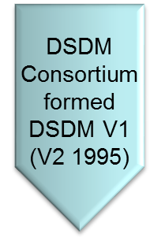
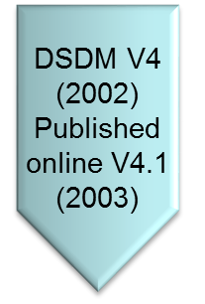
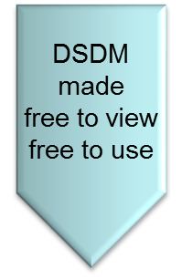
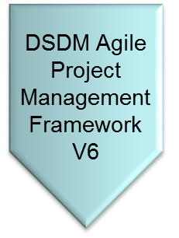







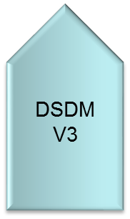
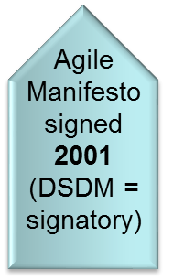
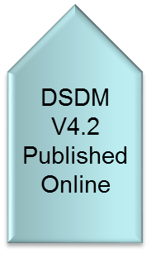
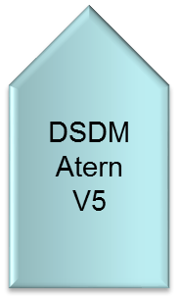
The History of DSDM
1994/5
1997
2002/3
2006
2007
2008
2014
Notes:
The timeline shows the progress made over a 20 year period, where the framework is updated and new versions are released.
Starting in 1994 with version 1 (V1); closely followed by V2 in 1995; revised in 1997 with V3; the Agile Manifesto was signed by the DSDM Consortium in 2001; V4 came in 2002 and was first published online in 2003; V4 was updated in 2006; the framework was made free to all in 2007; 2008 saw V5 newly named as DSDM Atern and in 2014 the latest version, V6 was renamed the DSDM Agile Management Framework.

Slide 7
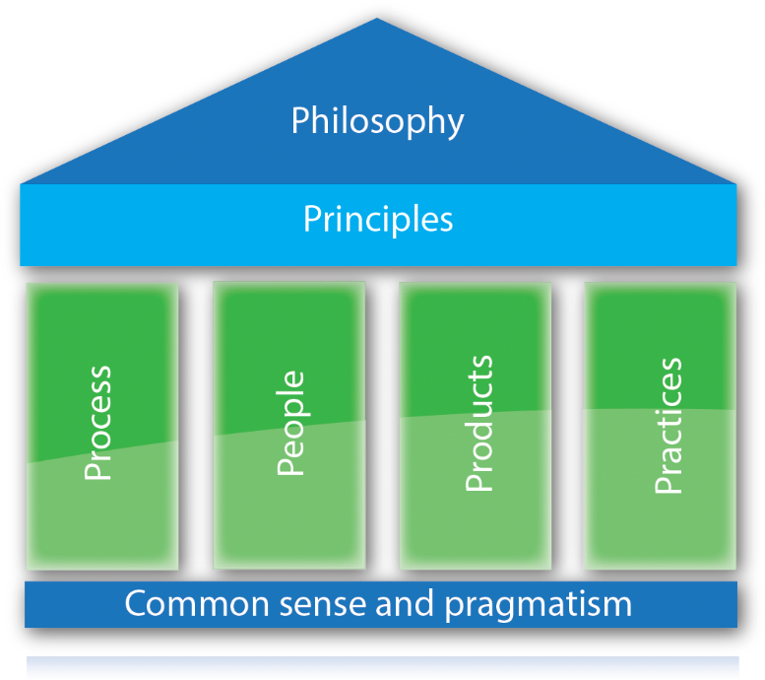
The Structure of DSDM
Source: Image from dsdm.org © 2016
Notes:
DSDM Agile Project Framework 2014 is built on a combined Philosophy that combines the key principles of Agile Development with the four key components;
Process
People
Products
Practices
Each playing an equal role in ensuring that the project is delivered; on time, to cost, without compromising on quality.

Slide 8
The Philosophy
Two important points to consider are:
    Any project must be aligned to clearly defined strategic goals;
    Any project must focus upon early delivery of real benefits to the business.
Notes:
To achieve the best results and meet with the philosophy that any project must be aligned to clearly defined strategic goal and focus upon early delivery of real benefits to the business DSDM uses the four key philosophies of the Agile Alliance:
Process - Individuals and interactions over processes and tools
Product - Working software over comprehensive documentation
People - Customer collaboration over contract negotiation
Practices - Responding to change over following a plan
And adheres to the 12 principles of the manifesto:
Our highest priority is to satisfy the customer
through early and continuous delivery
of valuable software.
Welcome changing requirements, even late in
development. Agile processes harness change for
the customer's competitive advantage.
Deliver working software frequently, from a
couple of weeks to a couple of months, with a
preference to the shorter timescale.
Business people and developers must work
together daily throughout the project.
Build projects around motivated individuals.
Give them the environment and support they need,
and trust them to get the job done.
The most efficient and effective method of
conveying information to and within a development
team is face-to-face conversation.
Working software is the primary measure of progress.
Agile processes promote sustainable development.
The sponsors, developers, and users should be able
to maintain a constant pace indefinitely.
Continuous attention to technical excellence
and good design enhances agility.
Simplicity--the art of maximizing the amount
of work not done--is essential.
The best architectures, requirements, and designs
emerge from self-organizing teams.
At regular intervals, the team reflects on how
to become more effective, then tunes and adjusts
its behaviour accordingly.

Slide 9





The Philosophy - 2
This is best achieved when key stakeholders …
Understand the business objectives
Are empowered to an appropriate level
Collaborate to converge on the best possible solution, in agreed timescale, according business priorities
Accept that change is inevitable
Are prepared to deliver a fit for purpose solution
Notes:
Collaboration is key to ensuring success in-line with the philosophy, however it must be complimented by;
Clear objectives
Empowerment to make decisions
Accepting of change
Prepared and focussed on delivery of the product

Slide 10





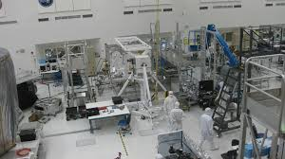
…Not just software!
Notes:
DSDM is not just used as a project management framework for the development of software. It is also used widely in other industries such as; Finance planning, Hospitals; Manufacturing, Construction, Business Change and Engineering to name a few.

Slide 11
The Benefits of DSDM
  The advantages of DSDM are:
    User ownership of the system is more likely
    Reduced risk of building the wrong system
    The final system is more likely to meet the users’ real business requirements
    Users will be better trained
    Deployment is more likely to go smoothly
Notes:
The key benefits of using DSDM centre around the impact on the end user. The processes adopted during development mean that the user will collaborate and form part of the project throughout the whole process. This inevitably means that they are far more likely to buy into the product once developed; the product delivered will meet the needs of the user; user training will be minimised and implementation of the product is likely to be much easier.

Slide 12
The 80/20 Approach
Level of
Functionality
Fundamental Assumption:
Nothing is built perfectly first time,
but 80% of the solution can be produced
in 20% of the time it would take to produce
the total solution.
100%
80%
60%
40%
20%
Development Time
0%
20%
40%
60%
80%
100%
Notes:
The rapid nature of DSDM means that the product/system will be quickly developed to approximately 80% of it’s required functionality in the first 20% of the allocated time. This allows for improvements to be made incrementally until the full 100% of required functionality is achieved, within budget and on time.

Slide 13

A Question of Balance
Speed
Risk Reduction
Notes:
Whereas traditional methodologies tend to tip the balance in favour of either the time it will take to complete a project or to ensuring minimal risk is incurred; DSDM helps to find the balance between the two. DSDM will ensure that projects are completed in a suitable time frame and minimise the risks of failure.

Slide 14




Components of a Business Solution
Business
Objectives
People
Process
Technology
Notes:
The Business solution starts with the businesses objectives and then the people and technologies feed into the process throughout the project.

Slide 15
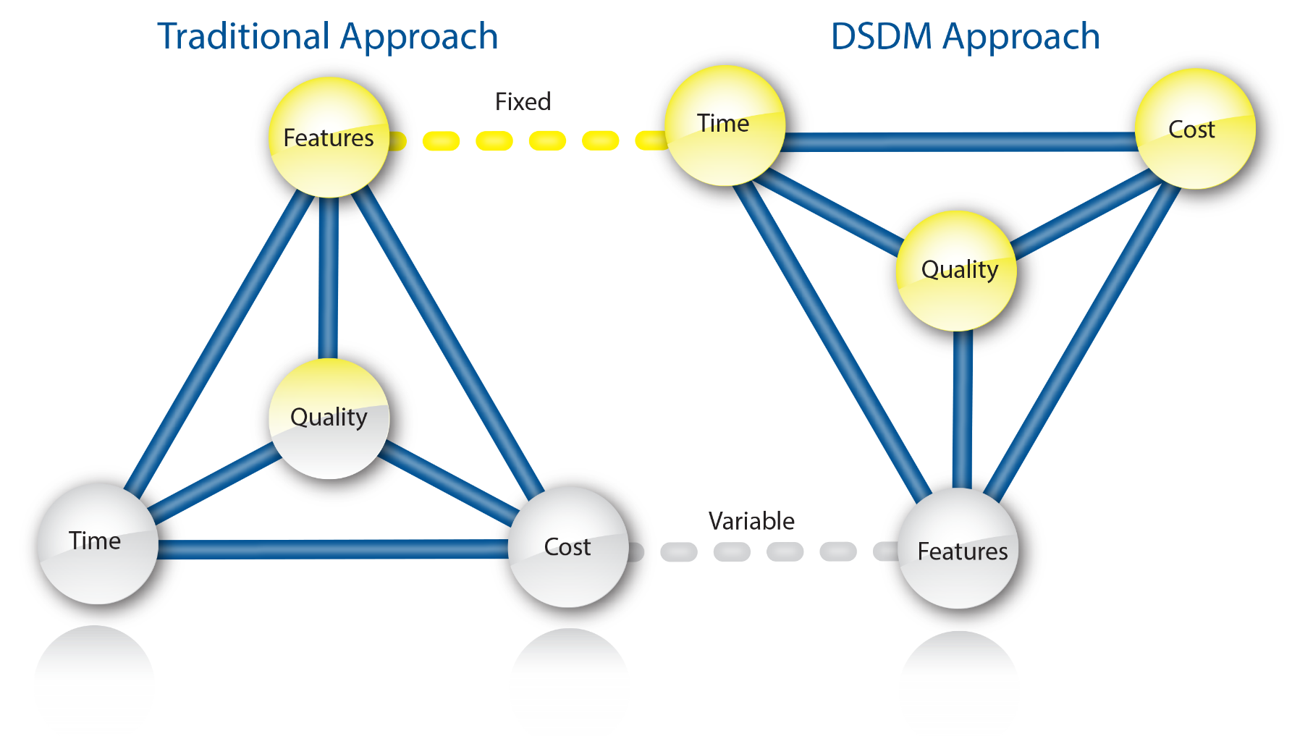
Flexible Requirements
Source: Image from dsdm.org © 2016
Notes:
DSDM allows for the requirements to be set at the initial stages, but they can change during the process providing the changes will ensure that the project is still delivered on time and to budget. Quality is never compromised with DSDM projects.

Slide 16
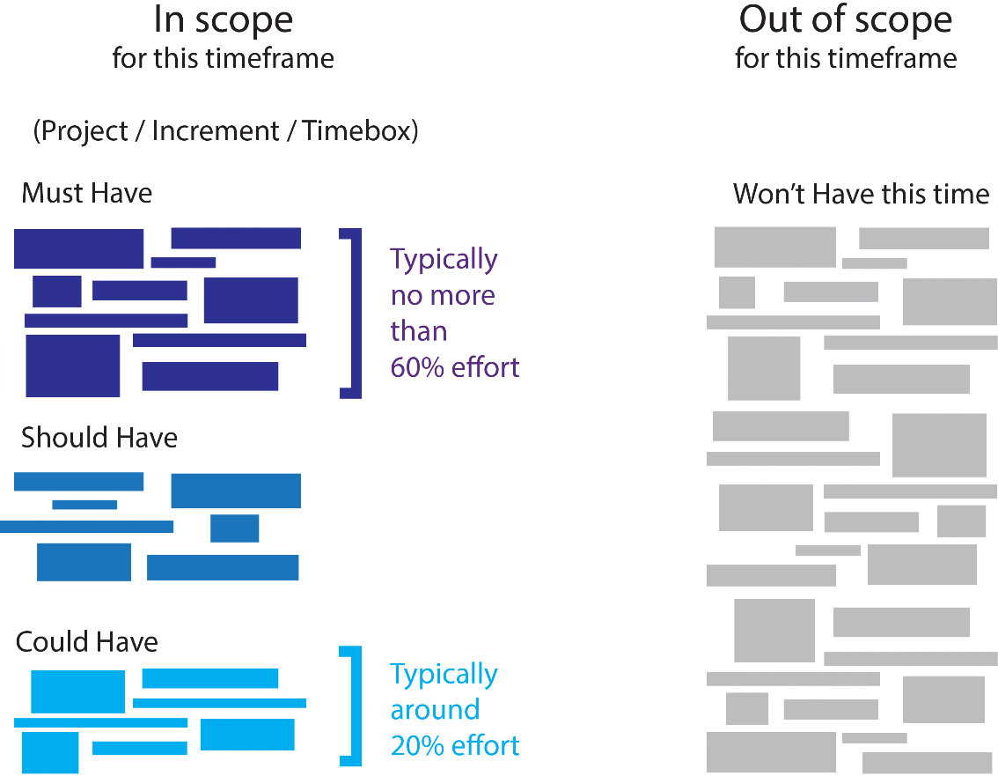
Prioritisation
DSDM uses the MoSCoW prioritisation model.
Concentrating approximately 60% of the project on the ‘Must Have’ requirements, and around 20% on the ‘Could Have’ requirements.
Source: Image from dsdm.org © 2016
Notes:
Prioritisation in DSDM is about balancing risk and predictability of project outcomes. At no stage though should the ‘Should Have’ or ‘Could Have’ requirements take precedence over the ‘Must Have’ requirements.

Slide 17
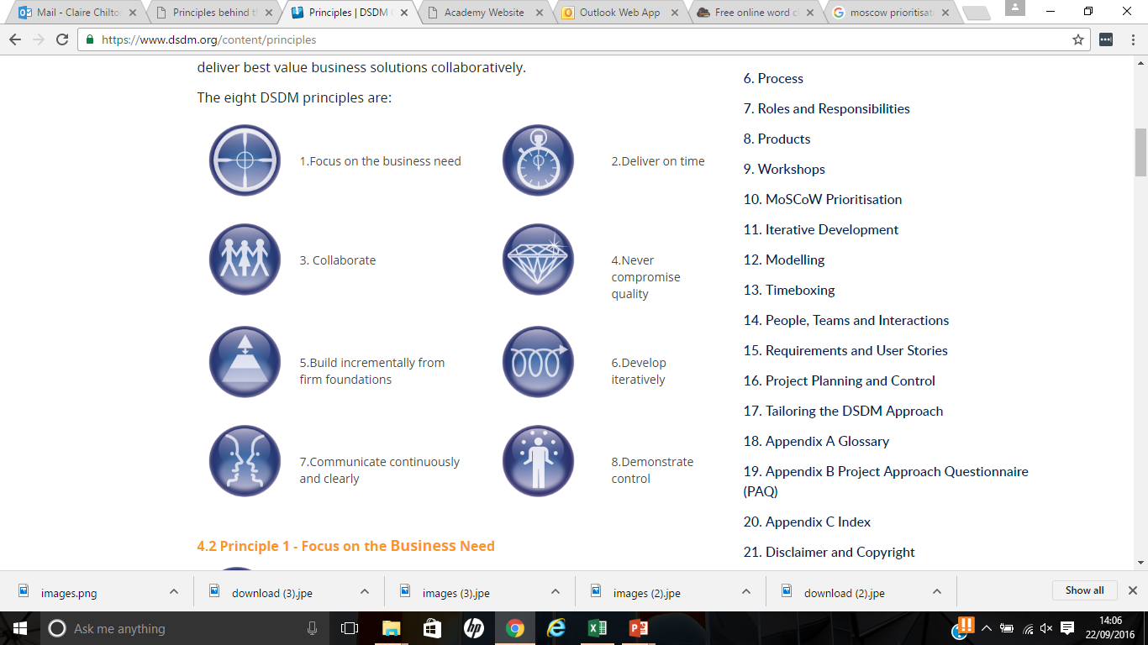
The 8 Principles of DSDM
1. Focus on business need
2. Deliver on time
4. Never compromise of quality
3. Collaborate
5. Build incrementally from firm foundations
6. Develop iteratively
7. Communicate continuously and clearly
8. Demonstrate control
Source: Image from dsdm.org © 2016
Notes:
The eight principles allow for clear focus to be implemented throughout the project.
If the foundations are effectively set at the start of the project ensuring focus; collaboration and communication are strong and control is maintained then the project will develop iteratively and incrementally to deliver the final project on time and to the highest quality.

Slide 18





DSDM - 5 Key Techniques
  MoSCoW Prioritisation
  Modelling
  Facilitated Workshops
  Iterative Development
  Timeboxing
Source: Image from dsdm.org © 2016
Notes:
DSDM uses;
MoSCoW to set the priorities for projects
Modelling to demonstrate elements using things like storyboard; illustrations; blue prints and so on
Facilitated workshops to build communication and showcase designs/ working parts
Iterative development, breaking the project into parts and developing them rapidly
Timeboxing to set clear blocks of time for set objectives to be met and delivered

Slide 19
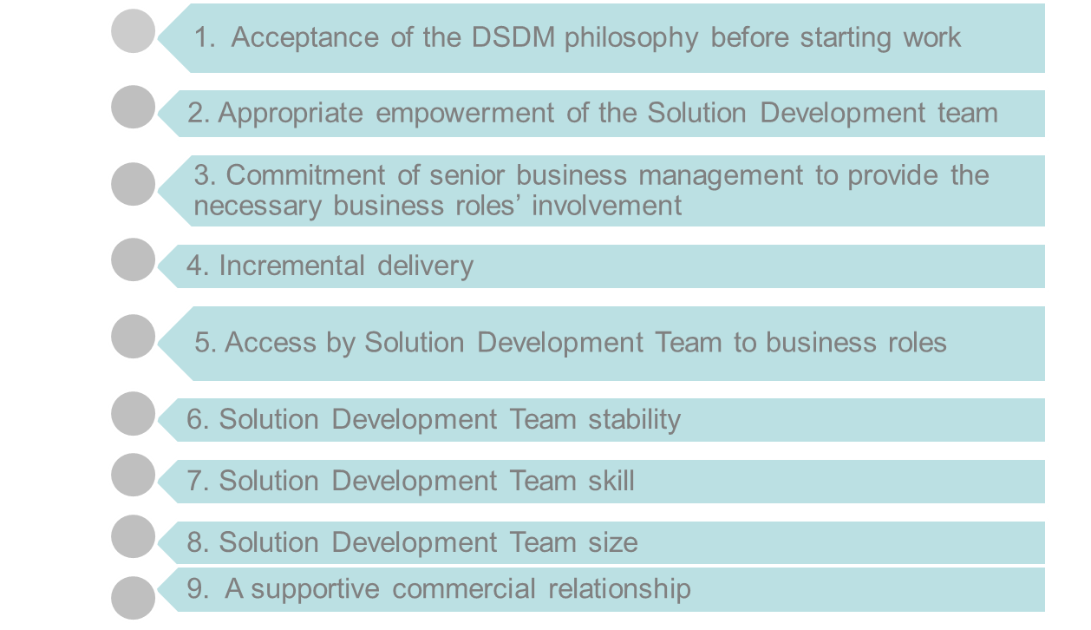
Instrumental Success Factors (ISFs) -
Reducing the risk
Notes:
To ensure success of any project there are several considerations to consider that will reduce the risks.
The DSDM Principles must be accepted as the core framework that the project will work within.
The team surrounding the project must be empowered, accessible, suitably able and consistently available, and have the full backing of senior management.
The project must be planned to be delivered in incremental phases.

Slide 20








What Kind of Projects?
Visible functionality
Clearly defined user group
Time constrained
Requirements are not
too detailed
or fixed
Project Approach
Questionnaire
Can be
Broken down
Requirements
can be prioritised
Not computationally complex
or complexity can be
decomposed or isolated
Notes:
It is important to be sure that the project will fit the DSDM approach. To help ensure that it is you need to ensure that these 7 key elements are true:
Visible Functionality
Time constrained
Can be broken down (particularly if large or complex)
Not computationally complex or possibility to decompose the project to management complexity
Requirements can be prioritised (MoSCoW)
Flexible requirements
Clearly defined user group
The DSDM Agile Project Framework (2014 Onwards) includes an example Project approach questionnaire that can be used to measure feasibility. https://www.dsdm.org/content/appendix-b-project-approach-questionnaire-paq

Slide 21
Summary of DSDM – 1
  DSDM is an Agile Project Delivery Framework that delivers the correct solution at the right time. The correct business solution is delivered because:
    The Project team and other significant stakeholders remain focused on the business outcome;
    Delivery is on time, which permits an early return on investment and reduced risk;
    All people involved with the project work collaboratively to deliver the optimum solution;

Slide 22
Summary of DSDM – 2
    Work is prioritised according to business need and the ability of users to accommodate changes;
    DSDM does not compromise quality.

Slide 23
Topic 2 – Approach and Principles
Any Questions?
Notes:
NCC Education - End Slide Master

